Slide 1

WATER QUALITY PREDICTION SYSTEM
(IV CSE B)
NITISH KUAMR D P | - | 610519104072
NARESH KUMAR D | - | 610519104069
MOHAN R | - | 610519104063
NANDAMUDI DINESH | - | 610519104067
UNDER THE GUIDANCE OF
Ms.N.RADHA,
ASSISTANT PROFESSOR,
DEPARTMENT OF COMPUTER SCIENCE AND ENGINEERING,
DHIRAJLAL GANDHI COLLEGE OF TECHNOLOGY ,SALEM

Slide 2
AGENDA
Domain introduction
Abstract
Literature Survey
Existing System
Proposed System
Workflow
Requirements
Modules
Results
Conclusion
Future Enhancements
Reference

Slide 3
INTRODUCTION
Water Quality prediction System designed to provide accurate and timely information on water quality
Uses IoT and machine learning algorithms to analyze various parameters such as pH, temperature, and dissolved oxygen to determine overall quality of water
Provides real-time predictions and alerts to help users make informed decisions about water usage and management practices
Essential tool for government agencies, water utilities, and communities that depend on safe and reliable water resources.

Slide 4
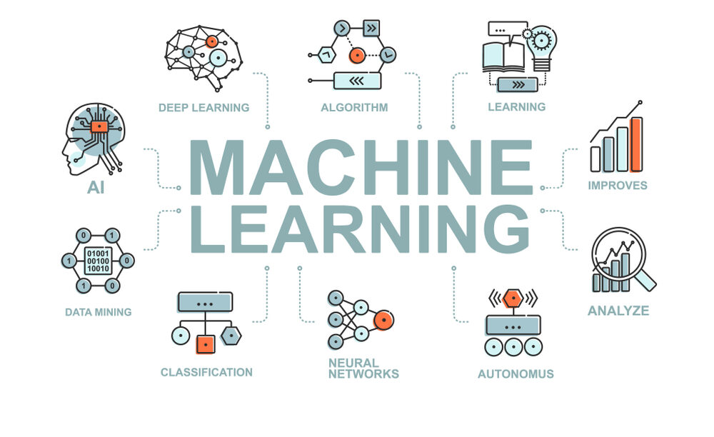
INTRODUCTION TO MACHINE LEARNING
Machine learning is a branch of artificial intelligence (AI) and computer science.
It focuses on using data and algorithms to imitate the way that humans learn.
Machine learning gradually improves its accuracy over time.
Machine learning is used in various applications, such as internet search engines, email filters, personalized recommendations on websites, banking software to detect unusual transactions, and voice recognition on mobile apps.

Slide 5

INTRODUCTION TO INTERNET OF THINGS
IoT is a network of physical devices, buildings, and objects with sensors, software, and connectivity.
It enables the exchange of data and interaction between devices and objects.
IoT technology is used in various applications such as smart homes, healthcare, transportation, and manufacturing.
The potential impact of IoT is significant, including creating a more efficient, productive, and sustainable world.
The number of connected devices in IoT is growing rapidly, with billions of devices already connected.

Slide 6
ABSTRACT
The goal is to predict water quality using machine learning and IoT.
Traditional water quality monitoring methods can be time-consuming, expensive, and inaccurate.
The machine learning-based approach uses supervised learning algorithms to predict water quality based on various factors.
The factors include pH levels, solids, hardness, sulphates, chloramines, trihalomethanes, organic carbon, conductivity, temperature, and turbidity.
The supervised learning algorithms used are decision trees, random forests, Extreme Gradient Boosting, and support vector machines.
The model will be trained on a dataset of water quality measurements and tested on a separate dataset to evaluate its accuracy.
The project aims to improve water quality management and ensure the safe and efficient use of water resources

Slide 7
LITERATURE SURVEY
In 2022, XGBoost performed moderately with 88% accuracy compared to CatBoost, which had the highest accuracy of 94% but still performed better than SVM, with only 80% accuracy.
In 2022, Another study on water quality classification using a tree-based ensemble model, XGBoost, is on par with the LightGBM classification method with 85% accuracy classification compared to other tree-based learning models such as Classification tree, Random Forest, and CatBoost
All the previous is very promising for the future of water quality prediction, especially with the current advances in portable electronic measurement devices.

Slide 8
EXISTING SYSTEM
Water quality is important for determining if water is safe for consumption.
Water Quality Index (WQI) is used to classify water safety.
Machine learning algorithms, SVM and XGBoost, can predict water quality using available parameters.
Parameters used for classification include: dissolved oxygen, pH, conductivity, biological oxygen demand, nitrate, fecal coliform, and total coliform.
Future research can improve water quality classification by using more parameters or advanced deep learning algorithms.

Slide 9
KEY ISSUES IN PREVIOUS SYSTEM
Sure, here are the main points from the paragraph
Many machine learning algorithms were not trained with the dataset.
There is a lack of detail about feature selection.
Feature selection is important for building machine learning models, and it would be helpful to know which features were selected for predicting water quality.
It would be helpful to know the average performance across different folds if cross-validation was performed to understand how well the models generalize to new data.
Water quality parameters cannot be obtained in real-time.

Slide 10
PROPOSED METHODOLOGY
The proposed system uses XG Boost, Random Forest, Support Vector Classifier
(SVC), Support Vector Machine (SVM) algorithms
Then for Real time Detection of water parameters IoT Sensors are being used
The parameters taken for Water Quality Prediction are pH, Hardness, Solids, Chloramines, Sulfate, Conductivity, Organic Carbon, Trihalomethanes, Turbidity
An Application is Developed to check the water quality.

Slide 11
WORK FLOW
Deploy Sensors
Collect Data
Pre -processing
Start
Generate Result
Prediction
ML Algorithms
Training
Stop

Slide 12
REQUIREMENTS SPECIFICATION
SOFTWARE REQUIREMENTS |  |  | HARDWARE REQUIREMENTS
Operating System | : | Windows OS | pH Sensor
Programming Language | : | Python, C | Temperature Sensor
Installation Software | : | Python | Turbidity Sensor
Platform | : | Visual Studio Code | Arduino UNO
 |  |  | ESP32866 Microcontroller
 |  |  | 16*2 LCD Display

Slide 13
MODULES SPLIT UP
Sensor module: This module is responsible for collecting data from various water quality sensors such as pH, temperature, turbidity, etc. The collected data is then transmitted to the central system through wireless communication protocols like Wi-Fi or LoRa.
Data acquisition and transmission module: This module is responsible for collecting the data from the sensor module and transmitting it to the central system. It may include microcontrollers, wireless communication protocols, and other hardware components.
Data storage and management module: This module is responsible for storing the collected data in a database or cloud-based platform, which can be accessed by the machine learning module for analysis and prediction.
Water Quality Prediction Module: This module uses advanced algorithms and techniques to analyze the collected data and predict water quality parameters such as pH, turbidity, conductivity etc. It may use supervised or unsupervised learning algorithms to train the model and make predictions.
User interface module: This module is responsible for providing a user-friendly interface to the end-users of the system, allowing them to predict the water quality.

Slide 14
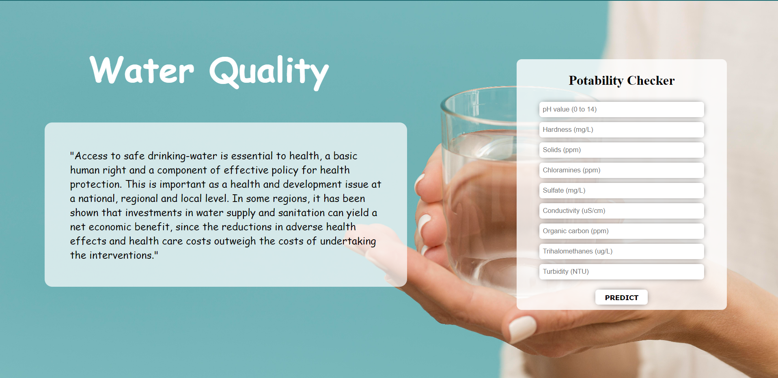
RESULTS

Slide 15
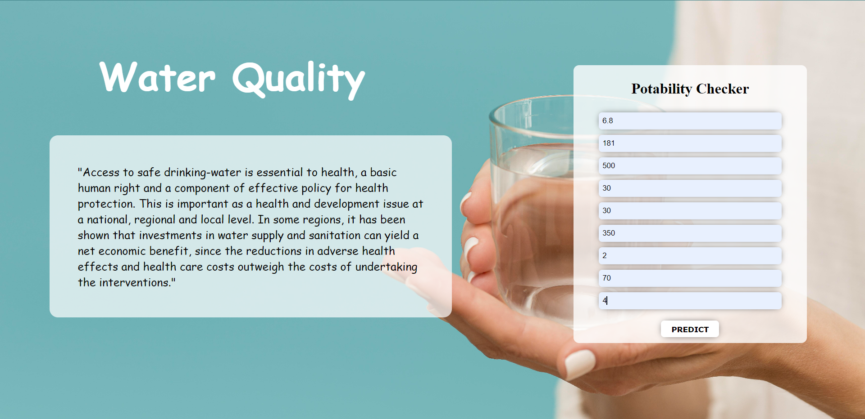

Slide 16
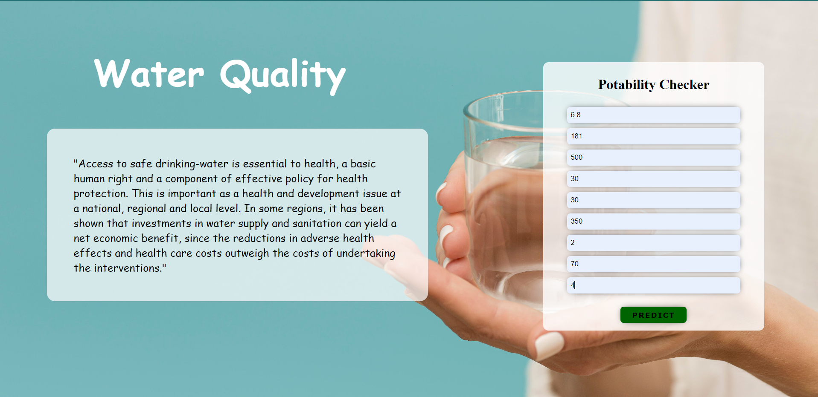

Slide 17


Slide 18


Slide 19

CONCLUSION
Water quality prediction systems are essential for ensuring the safety of our water supply.
These systems provide accurate and timely information on potential contaminants.
Advanced technologies and analytical tools are used to detect and prevent waterborne diseases.
Water quality prediction systems protect public health and promote environmental sustainability.
Investing in the development and implementation of these systems is crucial for community health and well-being.

Slide 20
FUTURE ENHANCEMENT
Integration with other water management systems for more comprehensive water management
Expansion of sensor capabilities to detect additional water quality parameters
Use of advanced machine learning techniques for improved accuracy and reliability of data
Cloud-based data storage and analysis for easier access and analysis of data
Predictive modeling to predict future water quality trends for proactive management
Autonomous decision-making to adjust treatment processes or alert professionals based on abnormal readings.

Slide 21
REFERENCES
F. Hassanbaki Garabaghi, "Performance Evaluation of Machine Learning Models with Ensemble Learning approach in Classification of Water Quality Indices Based on Different Subset of Features," 2021, DOI: 10.21203/rs.3.rs- 876980/v1.
L. Li et al., "Interpretable tree-based ensemble model for predicting beach water quality," Water Research, vol. 211, Mar. 2022, DOI: 10.1016/j.watres.2022.118078.
N. Nasir et al., "Water quality classification using machine learning algorithms," Journal of Water Process Engineering, vol. 48, p. 102920, Aug. 2022, DOI: 10.1016/j.jwpe.2022.102920.

Slide 22
THANK YOU

